Slide 1
VM Stress Calculation
25th April 2018

Slide 2
Introduction
API RP 2RD inputs
API RP 2RD Theory

Slide 3
Pipe Inputs
 |  | Units | Internal Pressure
Geometry
pipeNominalOD |  | m | 0.24765 | 0.24765
pipeNominalWT |  | m | 0.034925 | 0.034925
pipeMinimumWT |  | m | 0.034925 | 0.034925
pipeNominalID |  |  | 0.1778 | 0.1778
Material Properties
Yield Strength |  | ksi | 80
 |  | Pa | 5.52E+08
pipeA |  | m^2 | 0.023340213
pipeAi | Ai | m^2 | 0.024828666
pipeAo | Ao | m^2 | 0.04816888
pipeI | I | m^4 | 0.000135582
Loading
pipeExternalPressure | Po |  | 0
pipeInternalPressure | Pi | ksi | 0
pipeTensionEffective |  | N | 0
pipeMoment |  | Nm | 0
PipeTrueTension |  |  | pipeTensionEffective + (pipeInternalPressure*pipeAi) - (pipeExternalPressure*pipeAo)
T |  |  | Pi*Ai

Slide 4

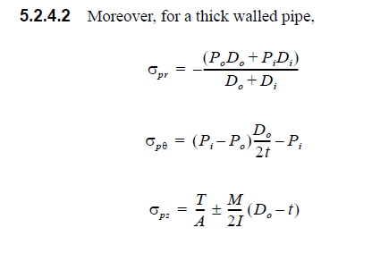
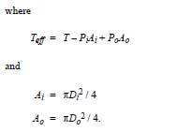
Theory
The vm stress is given below:
Each individual stress components are evaluated below

Slide 5
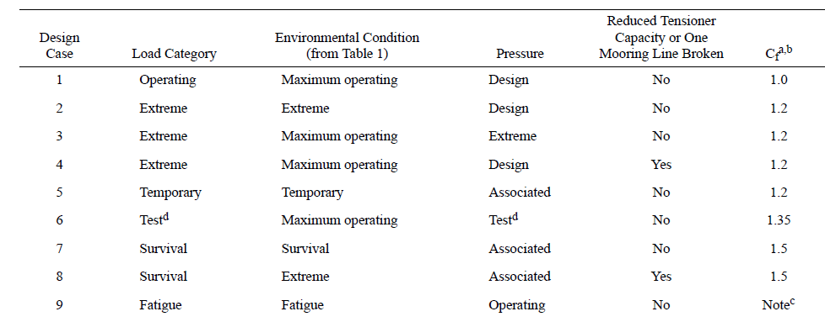
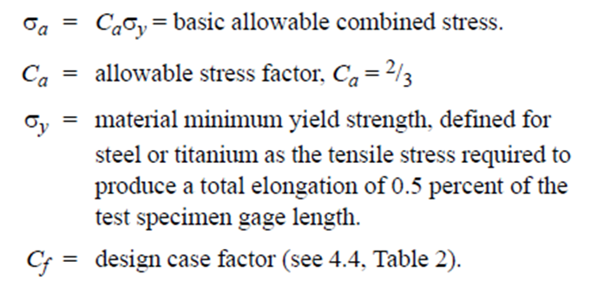
Theory

Slide 6
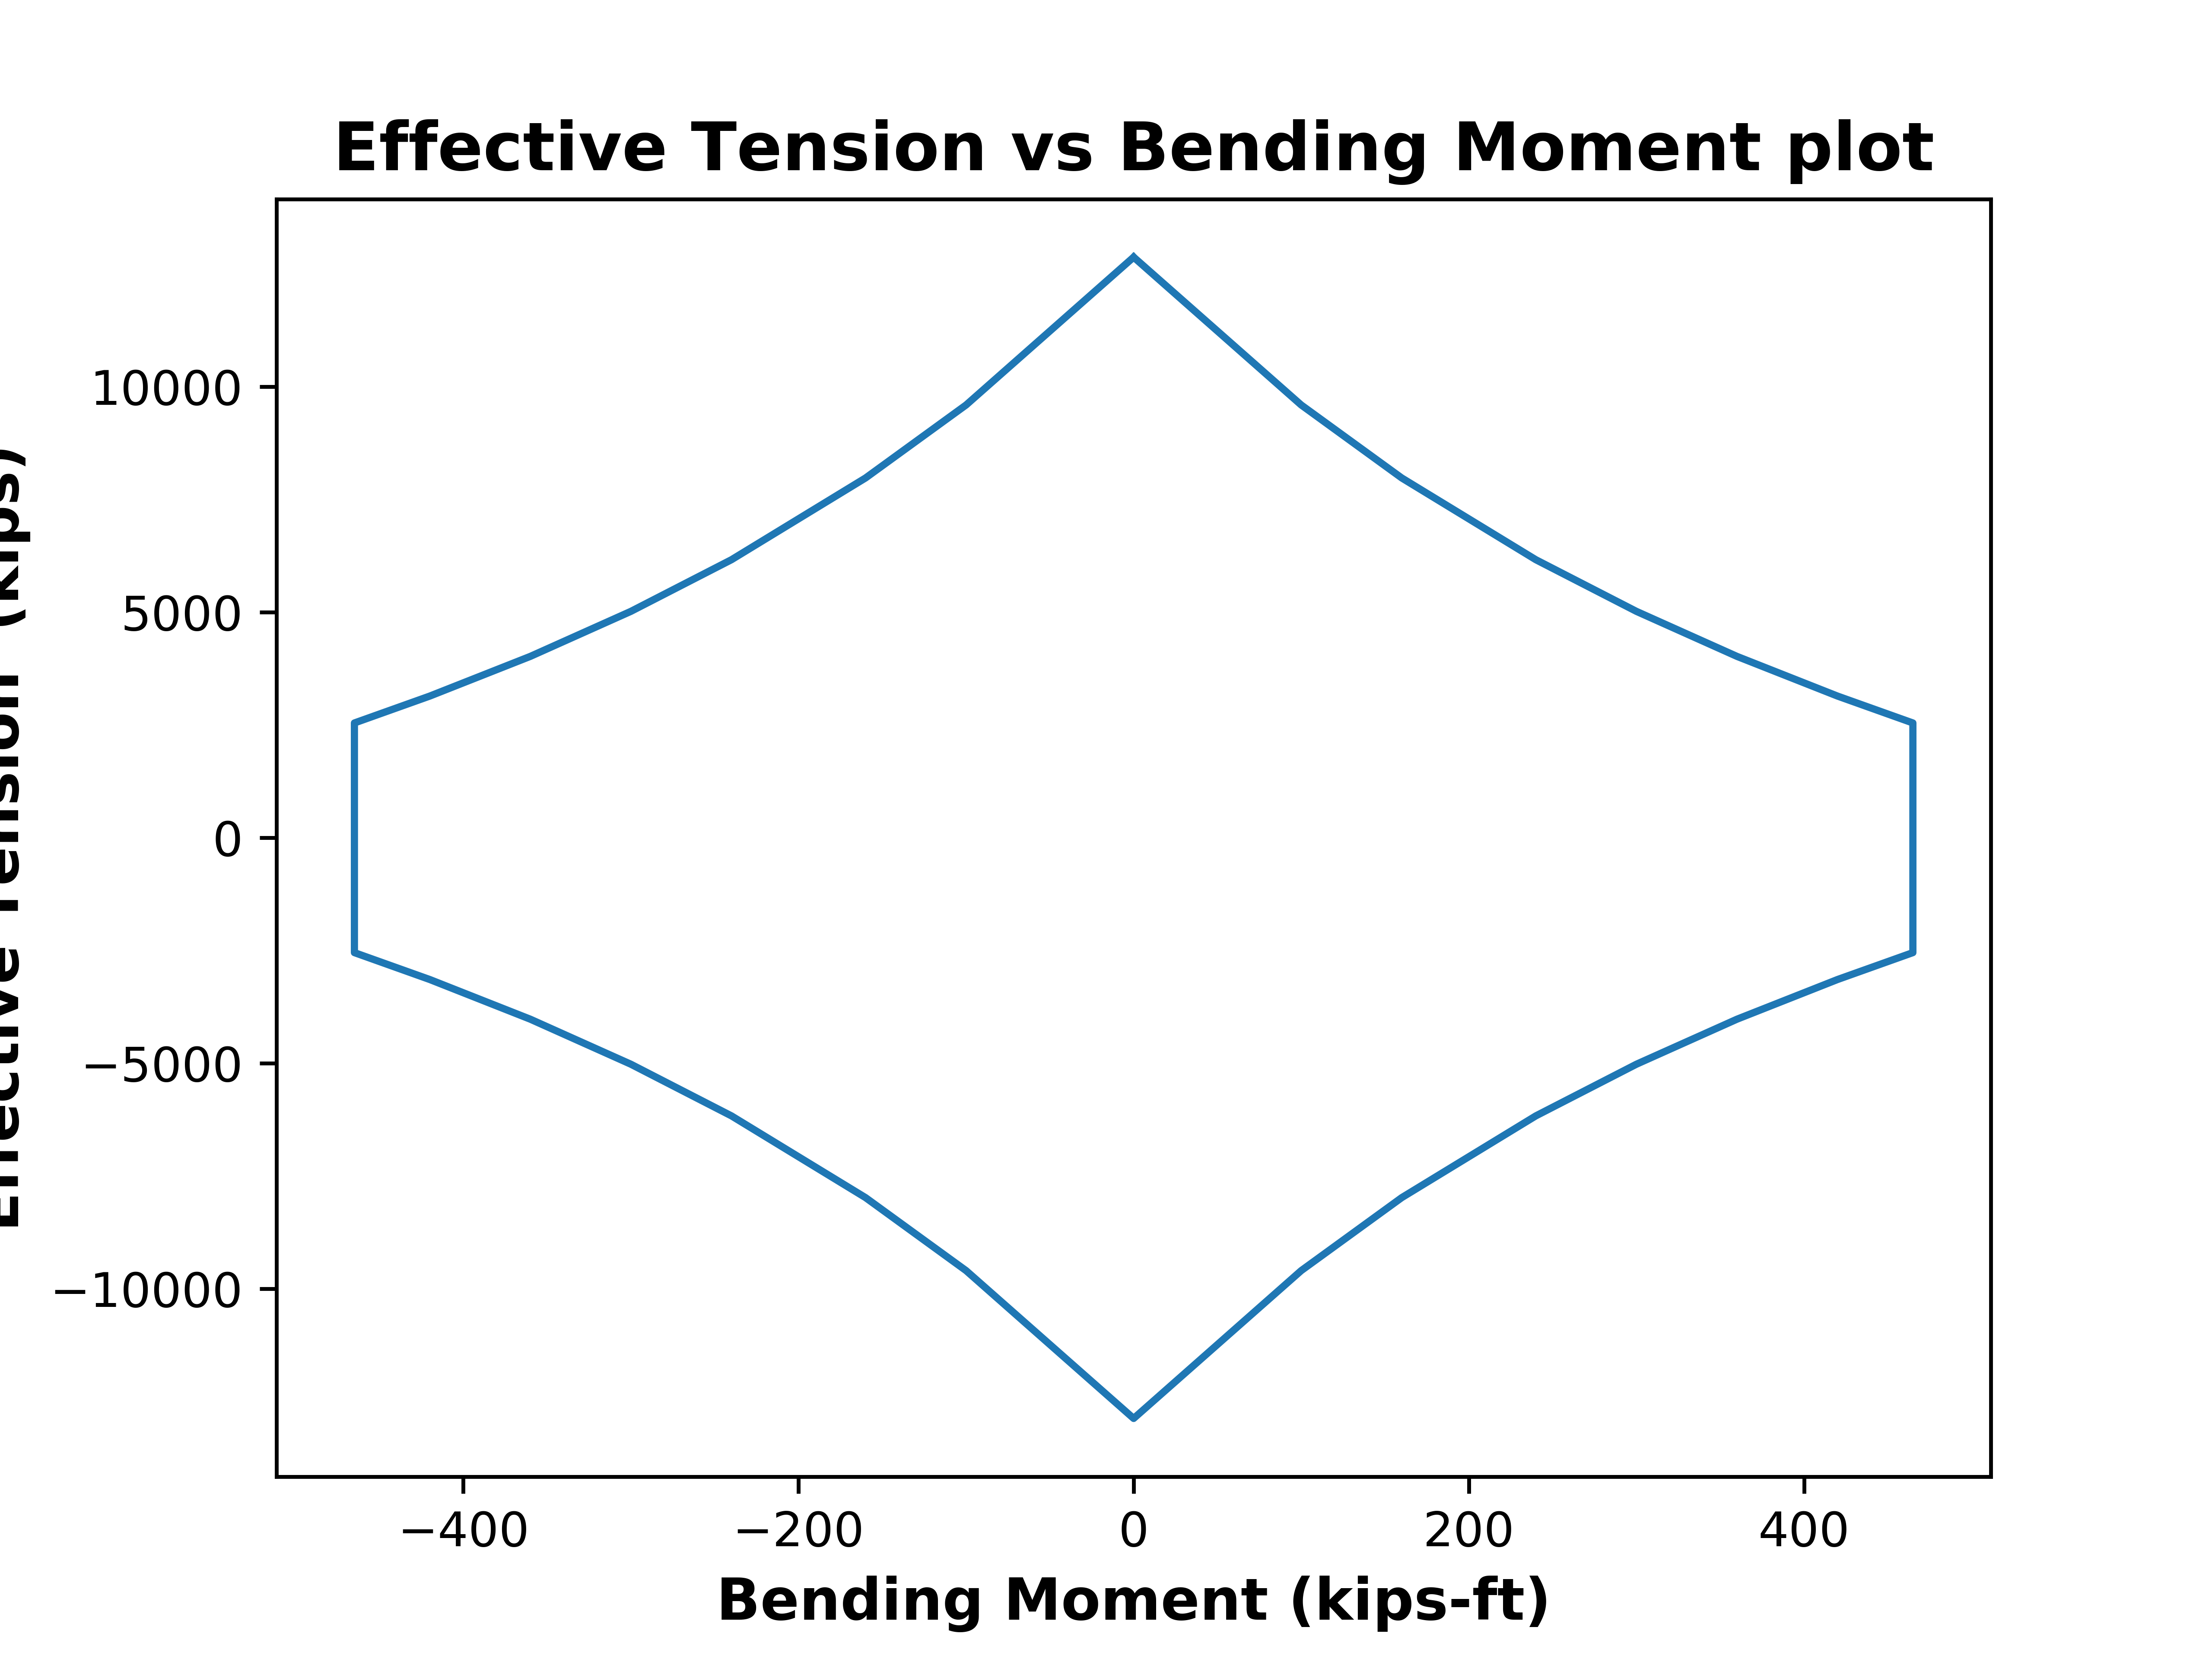
API RP 2RD Python Plot
0.0 | -100.0 | -160.0 | -240.0 | -300.0 | -360.0 | -420.0 | -465.0 | -465.0 | -420.0 | -360.0 | -300.0 | -240.0 | -160.0 | -100.0 | 0.0 | 100.0 | 160.0 | 240.0 | 300.0 | 360.0 | 420.0 | 465.0 | 465.0 | 420.0 | 360.0 | 300.0 | 240.0 | 160.0 | 100.0 | 0.0
12870.9 | 9593.9 | 7975.8 | 6164.2 | 5019.6 | 4021.7 | 3141.9 | 2545.5 | -2545.5 | -3141.9 | -4021.7 | -5019.6 | -6164.2 | -7975.8 | -9593.9 | -12870.9 | -9593.9 | -7975.8 | -6164.2 | -5019.6 | -4021.7 | -3141.9 | -2545.5 | 2545.5 | 3141.9 | 4021.7 | 5019.6 | 6164.2 | 7975.8 | 9593.9 | 12870.9

Slide 7
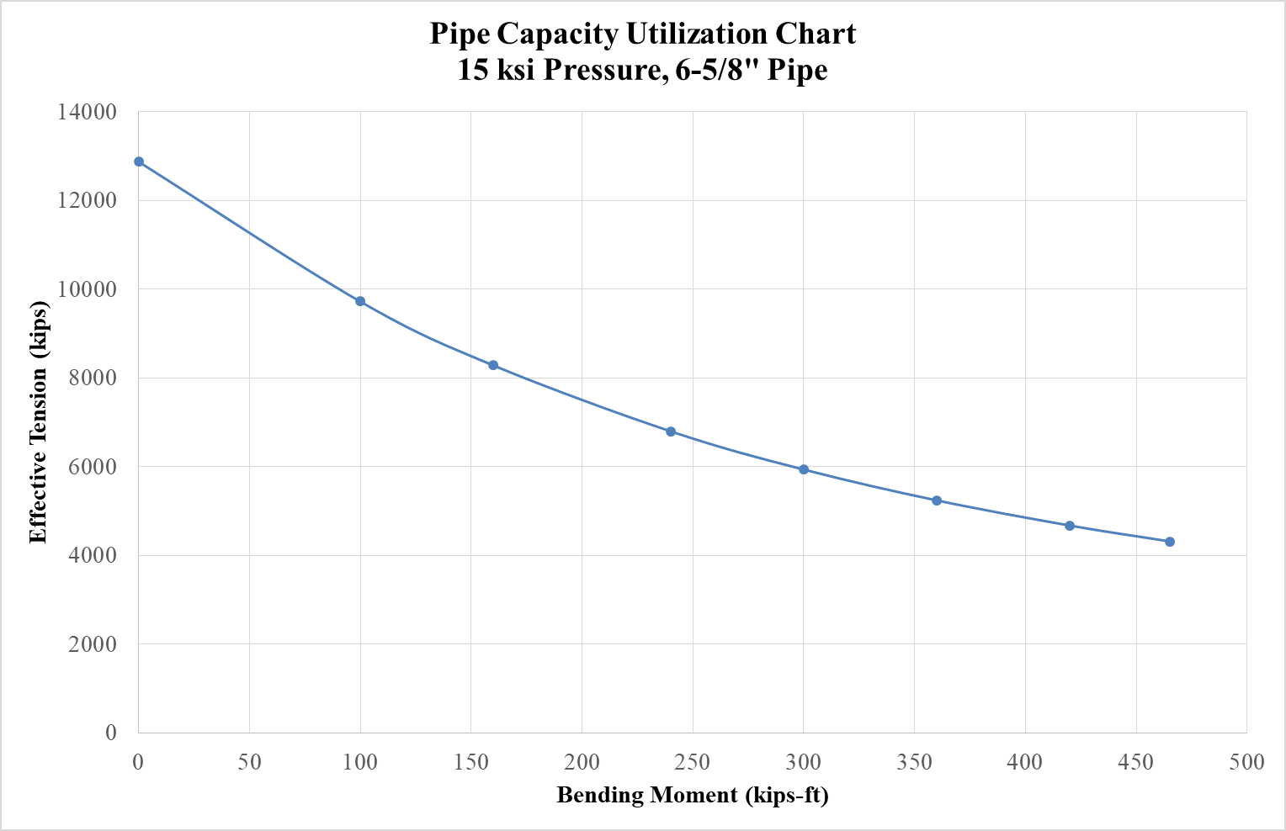
API RP 2RD Spreadsheet Plot
Bend Moment (Kips-ft) | 0.00 | 100.00 | 160.00 | 240.00 | 300.00 | 360.00 | 420.00 | 465.00
Effective Tension (kips) | 12870.91 | 9719.72 | 8282.59 | 6796.54 | 5935.94 | 5241.15 | 4674.94 | 4317.02

Slide 8
THANK YOU
For the opportunity to serve!

Slide 9
Document Revision History
01 | New Document | 8th Sept 2018 |  | VK
Rev | Description | Date |  | Author | Checked | Approved
Document No: |  |  | Client Ref:

